Slide 1


Slide 2
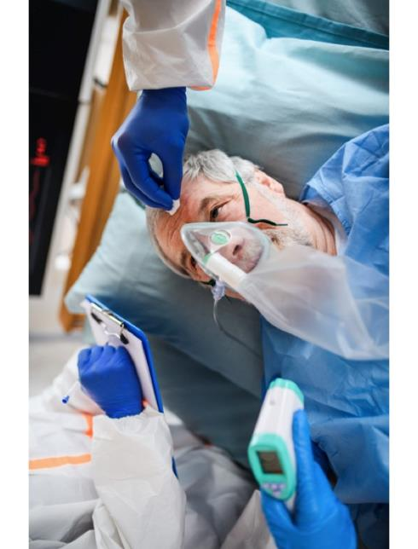
PROBLEM STATEMENT
Individuals with comorbidities are at higher risk of COVID-19
Determined hotspots via community risk stratification & social distancing
Positive impact on hospital in preparedness
U.S. Comorbidities
Diabetes | > 34 million people
Heart Disease | 30.4 million people
Lung Disease | 12.8 million people
https://www.cdc.gov/diabetes/basics/quick-facts.html
https://www.cdc.gov/nchs/fastats/heart-disease.htm https://www.cdc.gov/nchs/fastats/copd.htm
Notes:
Individuals with comorbidities are dying at a higher rate with COVID-19. Having the ability to determine hotspots through community risk stratification combined with social distancing behaviors will aide hospital in preparedness.
Early studies have shown that about 25% of people who went to the hospital with severe COVID-19 infections had diabetes.​
According to NYS data, hypertension is the leading comorbidity among fatal cases​

Slide 3

MEDIAN VALUE SAVINGS TO HOSPITALS
Single Hospitalized Patient $14,366
ICU Admission $14,991
$9,763 for patients without comorbidities
80% attack rate corresponds to a median cost of $654.0 billion
(Bartsch et al., 2020; Ray et al., 2020; Reynolds, 2020)

Slide 4
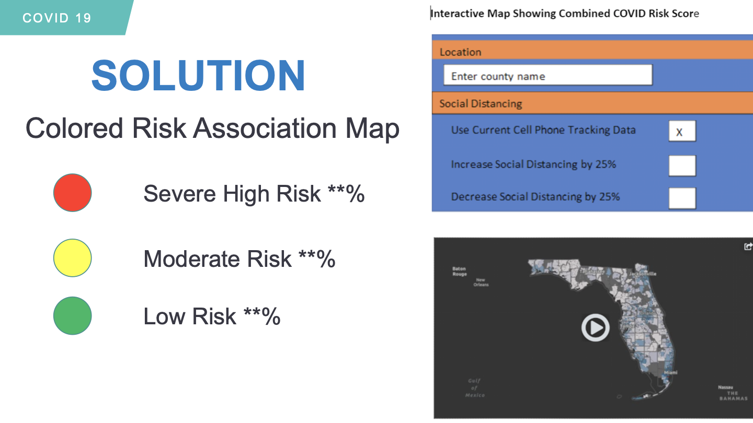
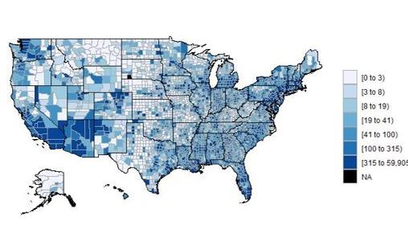
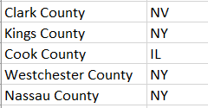
Predicted Hotspots
Notes:
Talking points:
1. What it is- web based application that provides a color coded risk association map
How it works- Stakeholders will be able to type in a county name and receive these as descriptive statistics, and the combined "risk" score will be visualized in a heat map. We plan to have a static version of the map by tomorrow and it may take some more time to develop an interactive map.
2. Real time based on data available?
3. Data sources
county in the US based on available
public health data on prevalence of: co-morbidities (lung disease, cardiovascular disease, obesity, diabetes)
social distancing scores
4. Scalability- begin with web based application to eventually develop to a mobile application 5. Standard infrastructure cost- website, maintenance, tech support; social distancing data cost- need further investigation
6. Development to Market- version 1, out in 30 days
***********************************************
programming this solution in R. This is a prototype map so far (as an example-- this is # of new COVID cases per county yesterday). The "Risk Score" formula will be comprised of 1/3rd comorbidity rate & age, 1/3rd social distancing adherence, and 1/3rd COVID infection rate. This is obviously not a validated formula but it shows an example of how this data can be combined. We are using the rates of these comorbidities in relation to the average rates in the US

Slide 5
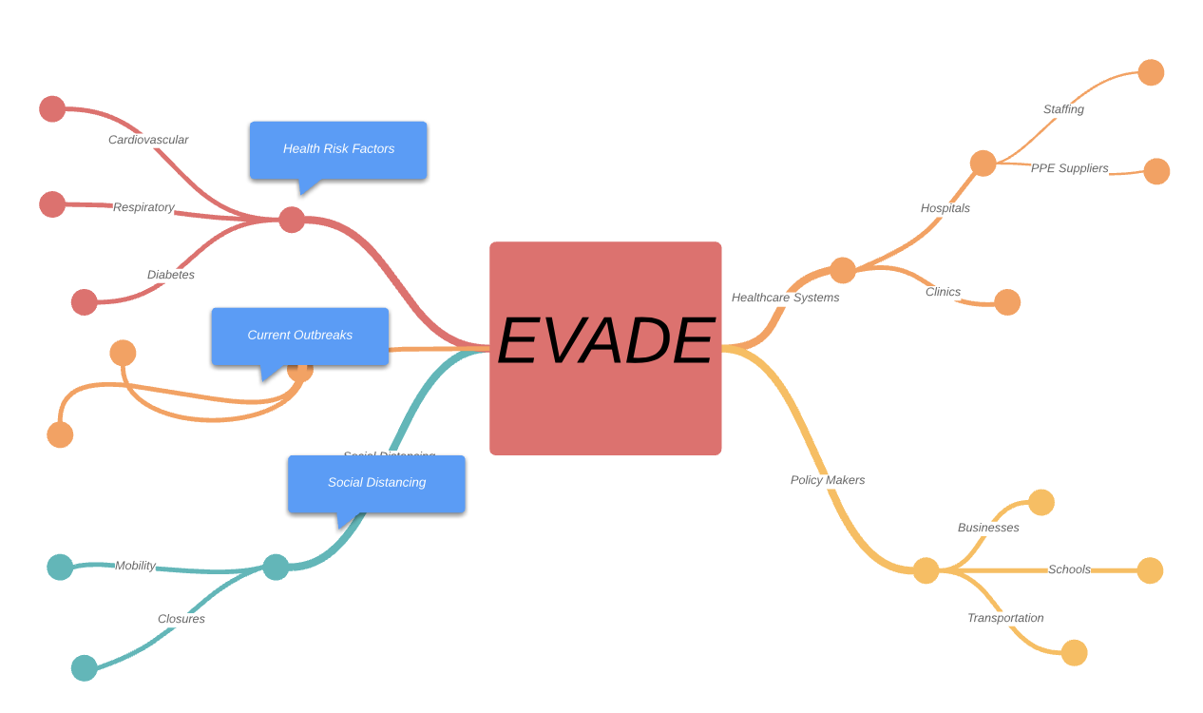
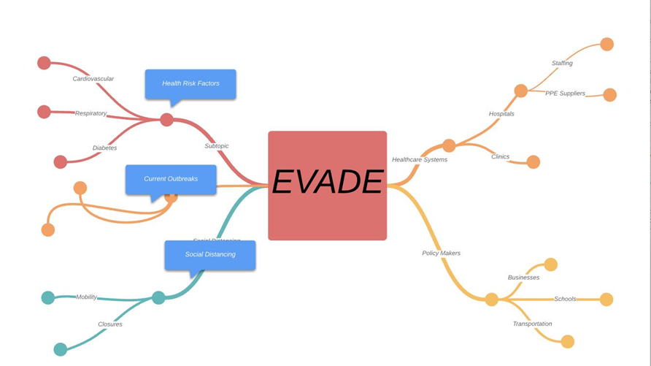
Notes:
This slide represents future development

Slide 6
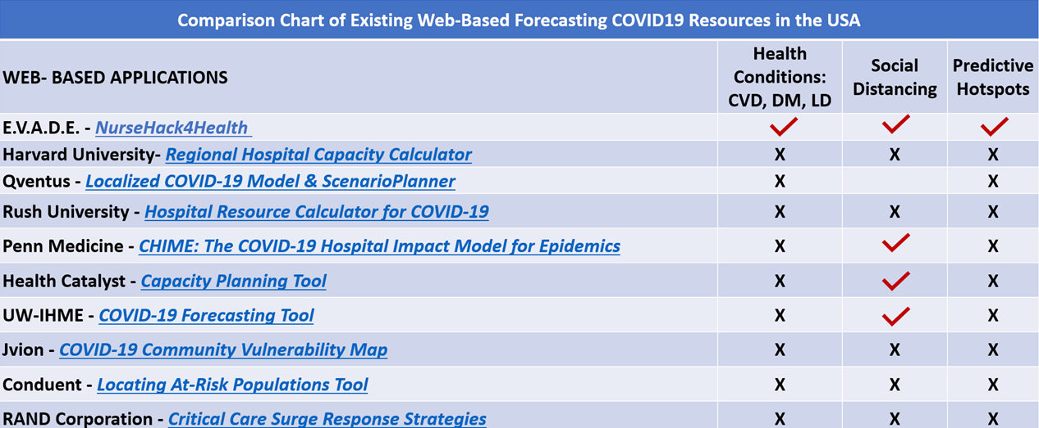
MARKET RESEARCH
Notes:
Unlike other existing forecasting applications, our EVADE solution takes into account health conditions and social distancing to predict covid19 hotspots in the U.S.

Slide 7

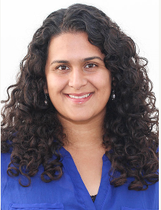
TESTIMONIAL
"Yes, this interactive tool will be useful to our organization in order to better allocate resources such as ICU beds, PPE, staff and hopefully we will be able reduce deaths and improve healthcare outcomes"
Nicolette Fiore-Lopez, PhD., RN
Chief Nursing Officer, St. Charles Hospital, NY
"I think the model would be useful. It also sounds like your model would be more granular. "
Anna Morgan, MD
Penn Medicine, Medical Director, COVID Watch
Notes:
Preliminary survey among executives and this is the feedback we received.

Slide 8
TEAM MEMBERS
Kimberly Farley, MSN, AGPCNP-BC (Philadelphia, Pa.)​
Jenna Cody, MS, Senior Statistician (New Jersey)​
Fraser Gutteridge, Systems Programmer IV, University of Delaware (DE)​
Wendy Pelton, MSN, Informatics, RN, CPAN (Virginia) ​
Mary Phillips, MSN, RN, CCRN (North Carolina)​
Anna Schoenbaum, DNP, MS, RN, (Philadelphia, Pa.)​
Megan Yuan, MSN Student, BSN, RN (New Jersey)​
Olga Kagan, PhD, RN (New York) ​
Olivia Velez, PhD MS MPH RN (New York) ​
Mary Anne Schultz PhD MBA MSN ​
Denika McPherson, MN-NP Student, BScN, RN, CNCC(C) (Toronto)​
Kelly Ayala, DNP, BSN (Milwaukee)​

Slide 9


COVID 19
THANK YOU
Notes:
I will open it up to my team

Slide 10
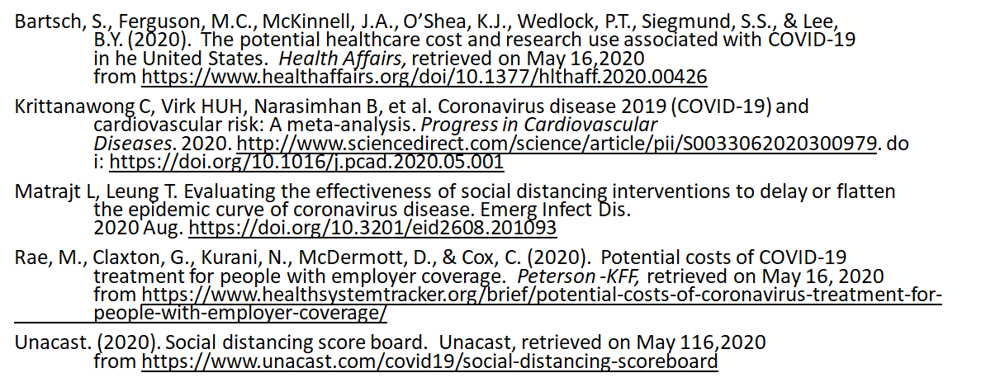
REFERENCES

